Slide 1
Left Smithianism
Daniel Klein, George Mason University
Institute for Humane Studies 2 December 2019

Slide 2
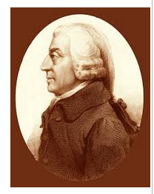
Like the Bible
multivocal
allegorical
esoteric
Irony, sarcasm, satire

Slide 3
Appeals to different perspectives.
But left Smithianism?
What about “the obvious and simple system of natural liberty”?
Are left Smithians saying that if Smith came back today he’d be on the political left?

Slide 4
Three duties of the sovereign
National defense
Internal night-watchman functions
“thirdly, the duty of erecting and maintaining certain public works and certain public institutions, which it can never be for the interest of any individual, or small number of individuals, to erect and maintain; because the profit could never repay the expence to any individual or small number of individuals, though it may frequently do much more than repay it to a great society.”

Slide 5
Samuel Fleischacker
The third duty “is broad enough to include practically all the tasks that modern welfare liberals…would put under government purview.” (2004, 234)
Smith: “plain and intelligible to common understandings”

Slide 6
Fleischacker
“The goal of a Smithian political economy would seem to be to enable each person in a society, as far as this is possible, to attain independence. This does not require governments to equalize wealth—that, he believes, would merely make everyone equally poor—but it does suggest, insofar as necessary, that governments should ensure that people are equally provided with the conditions for independence.” (1999, 182)
“Had Smith foreseen a world in which government measures might be necessary to bring about full employment, it is not at all clear that he would have opposed such measures.” (1999, 169)

Slide 7
Fleischacker
“What might a left Smithian propose…?”
“The left Smithian might propose a general plant-closing law…to try to minimize the sort of shock to a local economy that can result from the move of a large firm...”
“{A] left Smithian might promote an amendment to existing antitrust legislation: that it consider the potential monopsony a firm may hold over labor markets...”
“…firms above a certain size…would be required by law to set up a bicameral form of governance for themselves, in which one chamber would consist of employee representatives along with representatives of the communities in which the firms are located, while the other chamber continued to consist of stockholders.” (1999, 276-9)

Slide 8
Dennis Rasmussen
“[T]he pragmatic character of his approach suggests that he would be open to almost any possibility, including redistribution, social welfare measures, ‘living wage’ laws, and so on.” (Rasmussen 2008, 172)
Smith advocated “compulsory and state-supported education” (107).

Slide 9
Iain McLean
“[I]t is a stretch to believe that Smith was opposed to minimum wage legislation…” (McLean 2006, 136)
“Smith’s maxims of taxation warrant both progressive taxation and redistrution.” (140)
“Smithian social democracy fits some, but not all, of the ideas that we tend to call social-democratic… But, taking Smith’s work as a whole, I think he can only be classed as an egalitarian and left-wing philosopher.” (147)

Slide 10
An important conversation
Smith is central in liberalism
We engage and learn from one another
We learn Smith’s enduring relevance
We practice civil political discourse
We scrutinize texts
We dwell in the great mind

Slide 11
Politics is primarily directional
Not destinational.
Gordon Brown: “Would the Adam Smith who has been the inspiration behind the right-of-centre Adam Smith Institute be more likely to feel at home with the left-of-centre John Smith Institute?”

Slide 12
Eli Ginzberg (1934)
“Had Adam Smith been afforded the opportunity to review the problems of corporate enterprise in 1931 there is little doubt that his general approach would have been the same as in 1776: namely, a preoccupation with the public welfare. His conclusions might have differed greatly from those of his earlier analysis. … General objectives were his major concern; techniques had only a secondary interest for him.”
That-was-then-ism.

Slide 13
“Left”
Although sometimes favorable to liberalizations:
drugs, sex, abortion, immigration
The left tends to support status-quo interventions, redistribution, welfare state, govt programs.
And new interventions, new give-aways, entitlements.
Rarely advocate school choice, privatization, liberalization of land-use restrictions, occupational licensing, FDA, gun rights, etc.
Push in the direction of the greater governmentalization of social affairs, even if they suffer from some denial about that.

Slide 14
I agree that…
Smith was not a Murray-Rothbard libertarian.
Has anyone claimed that Smith was?
Murray Rothbard attacked Smith.
Was Smith any kind of libertarian?
I have criticized “niche libertarianism”.

Slide 15
The left Smithians are overplaying their hand.

Slide 16
Early intimations of left Smithianism
William Thompson, John Gray, John Francis Bray
Karl Marx
Albion Small
Max Lerner
Eli Ginzberg (1934)
Spencer Pack → 1990s Emma Rothschild, Samuel Fleischacker, to present, many others

Slide 17
Critics of left Smithianism
James Otteson
Craig Smith
Douglas Den Uyl
Kenneth I. Macdonald
David D. Friedman
Christopher Martin
Michael Clark
Paul Mueller

Slide 18
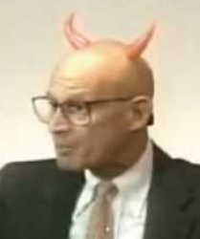
Some general criticisms of left Smithianism
Inappropriate standards for saying Smith “left”:
Sustained the holiness of the whole.
Egalitarian: (1) everyone counting equally; (2) equality before the law.
Individuals are not atoms.
Markets depend on moral, cultural, institutional preconditions.
Didn’t advocate greed.
Not a laissez-faire dogmatist.
Knew that a shilling meant more to a poor person than it does to a rich person.
Not destinational.
Fail to give due weight to the CL element.
That-was-then-ism.
Over-emphasize and misrepresent particular bits of text.

Slide 19
Emma Rothschild
Smith “is tolerant in his view of government interference, especially when the object is to reduce poverty. One example is his remark about equitable wage regulations; another is his support for progressive taxes on carriages…” (Rothschild 2001, 69)

Slide 20
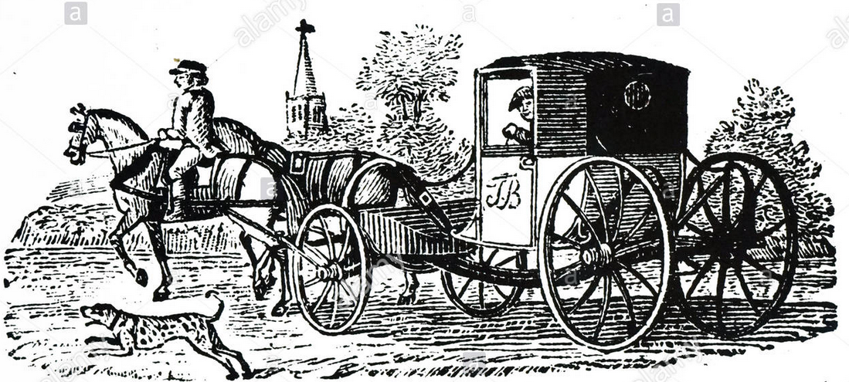
The text
“When the toll upon carriages of luxury, upon coaches, post-chaises, &c. is made somewhat higher in proportion to their weight, than upon carriages of necessary use, such as carts, waggons, &c. the indolence and vanity of the rich is made to contribute in a very easy manner to the relief of the poor, by rendering cheaper the transportation of heavy goods to all the different parts of the country.” (WN, 725.5)

Slide 21
It’s a toll, not a tax.
Does Smith every endorse luxury taxes on the rich?
Kenneth Macdonald (2019) really good.

Slide 22
& Robert Reich
“‘The rich should contribute to the public expense, not only in proportion to their revenues, but something more than in that proportion,’ Smith writes.” (Gopnik 2010, 87)
What comes before?
“Of course the rich…”
“It is reasonable that the rich…”
“It is not unreasonable that the rich…”
“It is not very unreasonable that the rich…”
And it is about a building/ground-rent tax.

Slide 23
1st maxim of taxation
“I. The subjects of every state ought to contribute towards the support of the government, as nearly as possible, in proportion to their respective abilities; that is, in proportion to the revenue which they respectively enjoy under the protection of the state. … ” (WN, 825.3)
“The evident justice and utility of the foregoing maxims…” (827.7)

Slide 24
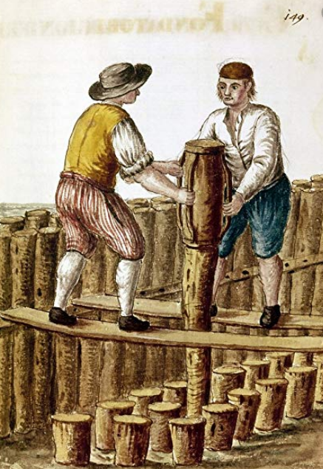
Amartya Sen
“[Smith] gives a formula of disarming simplicity: ‘When the regulation, therefore, is in favour of the workmen, it is always just and equitable; but it is sometimes otherwise when in favour of the masters.’”

Slide 25
The surrounding text
“Whenever the legislature attempts to regulate the differences between masters and their workmen, its counsellors are always the masters. When the regulation, therefore, is in favour of the workmen, it is always just and equitable…” (WN, 157-8.61)

Slide 26
Smith’s example of an existing regulation in favor of workmen
“Thus the law which obliges the masters in several different trades to pay their workmen in money and not in goods, is quite just and equitable.” (WN, 158.61)

Slide 27
“… equity, besides…”
“It is but equity, besides, that they who feed, cloath and lodge the whole body of the people, should have such a share of the produce of their own labour as to be themselves tolerably well fed, cloathed and lodged.” (WN, 96.36)

Slide 28
Christopher Martin
Equity, besides: Adam Smith and the utility of poverty.
J. Hist. Econ. Thought 2015
Adam Smith and the Poor: A Textual Analysis
J. Econ. Beh. and Organization, forthcoming
Adam Smith and Liberal Economics: Reading the Minimum Wage Debate of 1795-96.
Econ. J. Watch 2011

Slide 29
Amartya Sen
“He defended such public services as free education and poverty relief…”

Slide 30
Did Smith defend poverty relief?
Smith conspicuously did not weigh in on the poor law itself.
Some left Smithians have said, in effect: See, he wasn’t opposed to it.
But may we equally say?: See, he wasn’t in favor of it.

Slide 31
WN is a quite comprehensive
In “Introduction and Plan of the Work” Smith says that in Book V he has “endeavoured to show…what are the necessary expences of the sovereign, or commonwealth” (12.9)
Smith repeats those words almost verbatim (688.52).
“necessary expences” ~ enumerated powers

Slide 32
Amartya Sen
“He defended such public services as free education and poverty relief…”

Slide 33
Schooling
Scott Drylie,
Adam Smith on Schooling:
A Classical Liberal Rereading,
J. Econ. Beh. & Organization, forthcoming.

Slide 34
Schooling
Smith’s final words on the subject:
The expense for schooling “might perhaps with equal propriety, and even with some advantage, be defrayed altogether by those who receive the immediate benefit of such education and instruction, or by the voluntary contribution of those who think they have occasion for either the one or the other.”

Slide 35
Left Smithians undo the spine of Smith’s thought
CJ is not messing other people’s person, property, promises due.
“precise and accurate”
Liberty is others not messing with one’s stuff
The spine = CJ/liberty
The spine, not the head, hands, or heart
The jural logic of one’s own

Slide 36
Fleischacker:
“Are there any sharp criteria by which to distinguish ‘real and positive hurt’… from the mere absence of good?” (2004, 150)
“[T]he ‘natural’ borders of justice are blurry, not sharp, and...they cannot be clarified by way of a prelegal, presocial notion of harm.” (157)

Slide 37
Fleischacker:
“If justiciable harm is a socially relative category, it will be difficult to find any laws of justice that must be realized by every society.” (158-9)
“It is therefore not true that we can find… a basis for a clear and precise notion of justice across all societies.” (156)

Slide 38
Fleischacker
Attributes to Smith an idea of an invariant grammar-like CJ. And says that’s misguided.
Says Smith says that CJ is subordinate to higher forms of justice.
Left Smithians remove the spine of Smith’s outlook.

Slide 39
Fleischacker:
“It is therefore quite reasonable to look on my earnings as not purely ‘my’ money…”(194)
Fleischacker undoes CJ and therefore liberty.

Slide 40
Denial?
Are left Smithians in denial about how deeply their thinking collides with Smith?
Again, think of politics as directional.

Slide 41
Taboo
Taboos surround the whole idea of CJ/liberty.
Today and in Smith’s time…
The liberty idea is challenging and frightening.

Slide 42
Ceiling on interest rates
Jonathan H. Diesel,
Adam Smith on Usury:
An Esoteric Reading,
J. Econ. Beh. & Organization, forthcoming.

Slide 43
Ceiling on interest rates
When Adam Smith endorses the status-quo policy of a ceiling on interest rates, saying that without such ceiling “[s]ober people…would not venture into the competition” for loans, he then immediately says that under the status-quo policy “sober people are universally preferred, as borrowers, to prodigals and projectors”.
If lenders can discern soberness with the ceiling, why wouldn’t they be able to discern soberness without a ceiling?
Bentham

Slide 44
Doing justice to the CL drift of Smith
“Adam Smith presumption-of-liberty passages”
“All systems…”
Almost all of the exceptions that Smith made were status-quo policies.
That is, he almost never advocated a new reduction in liberty.
Leslie Stephen: “Smith dealt over-delicately with some existing restrictions… [T]he exceptions which he admits are remnants of old prejudices rather than anticipations of any new principles.” (1876, 322-3)

Slide 45
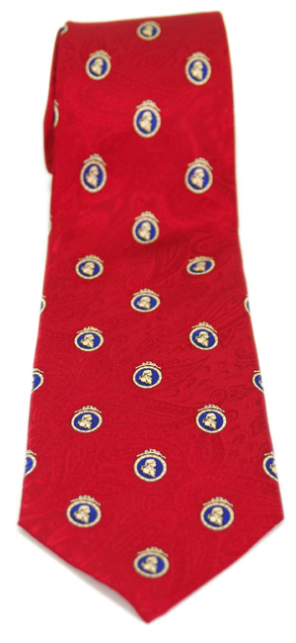
Will the true Adam Smith please stand up?

Slide 46
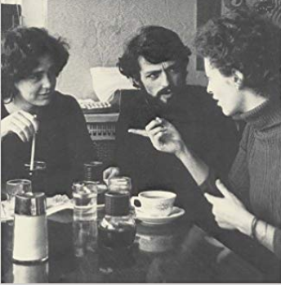
May the conversation continue

Slide 47
Thank you for your attention!

